Slide 1
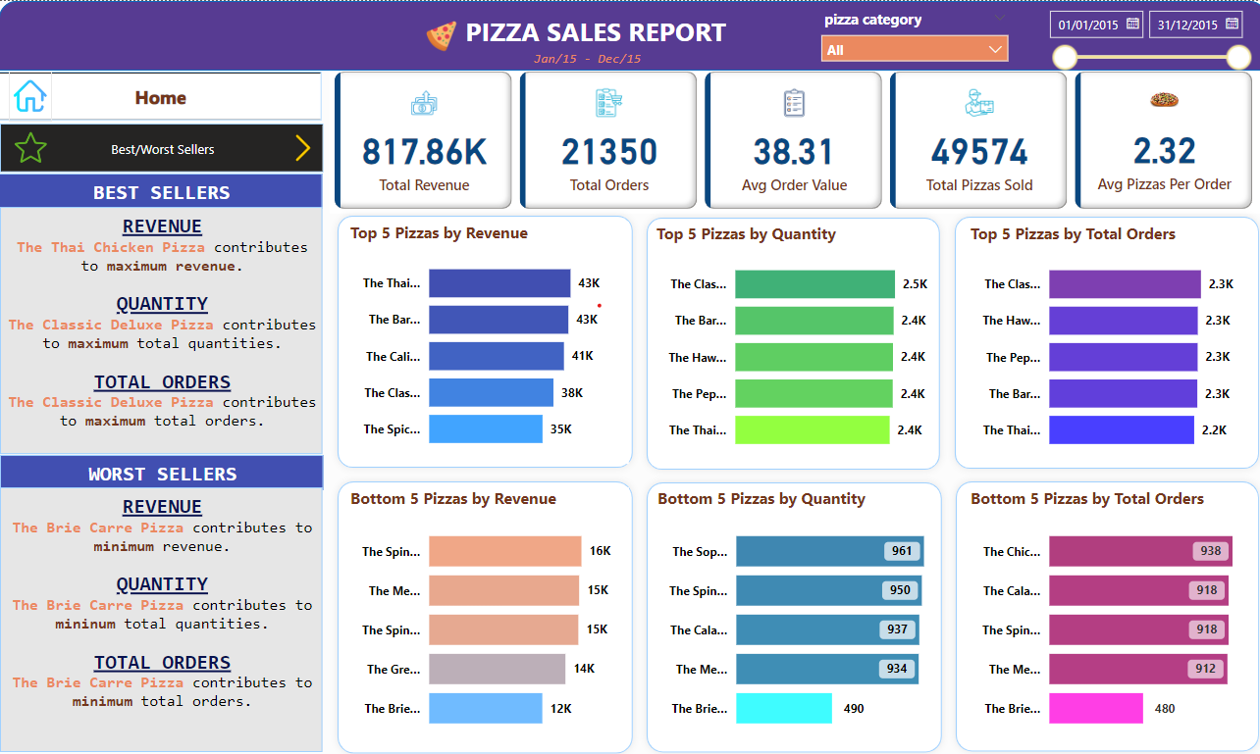
PowerBI Project – PizzaSales Dashboards

Slide 2
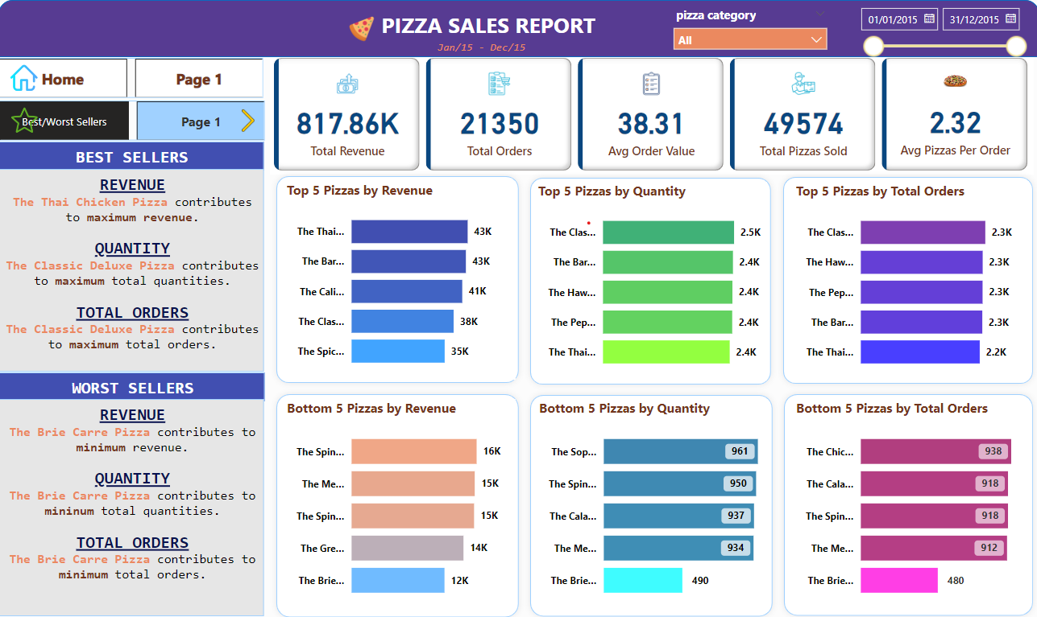
PowerBI Project – PizzaSales Dashboards

